Slide 1
Group 9
Amod Upadhye
Hitesh Somani
Nidhi Kohli
Palash jain
Priyanka Langade
Shivam Alias Rhitvij Manish Parashar

Slide 2
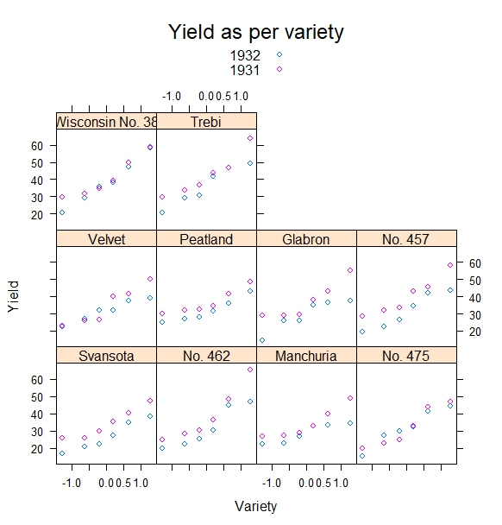
Lattice Graph
The graph gives the yield distribution for different varieties of barley for the year 1931 and 1932
The yield for all varieties was less in 1932 as compared to the yield in 1931
In 1932, Manchuria has the least yield whereas Wisconsin No. 38 has the highest

Slide 3
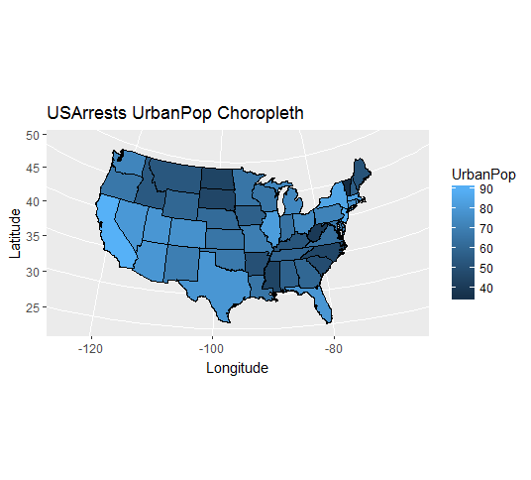
USA Choropleth
This graph represents the percent of Urban Population in states.
It shows that more Urban Population lives on the south and south-west of USA.

Slide 4
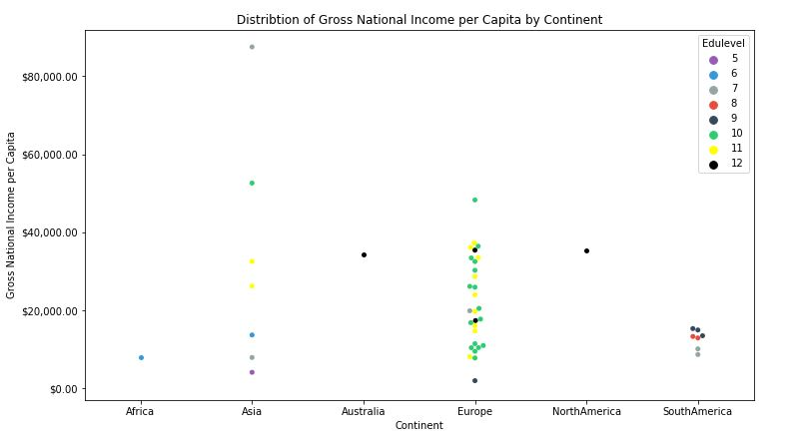
Swarmplot
The country in Asia with marginal high gross national income is Qatar.
Few countries in Europe even being highly educated have lower Gross National Income.
This may suggest that Education might not be the only or major factor to increase Gross National Income

Slide 5
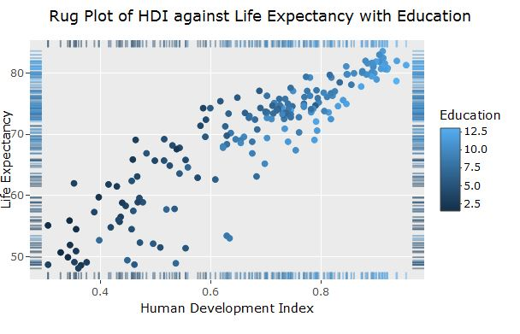
Rug Plot
This graph shows a rug graph created with geom_rug, which shows the positions of the data points along x and y are denoted by tick marks, reminiscent of the tassels on a rug.
This graph compares the distributions of Human Development Index and Life Expectancy of an individual for a country. Additionally, we have also compared the Education Levels for those countries using the color property.
Interactive plot is available here: https://amod-upadhye.github.io/hw4/

